Slide 1
Cape Town
Jane Battersby

Slide 2
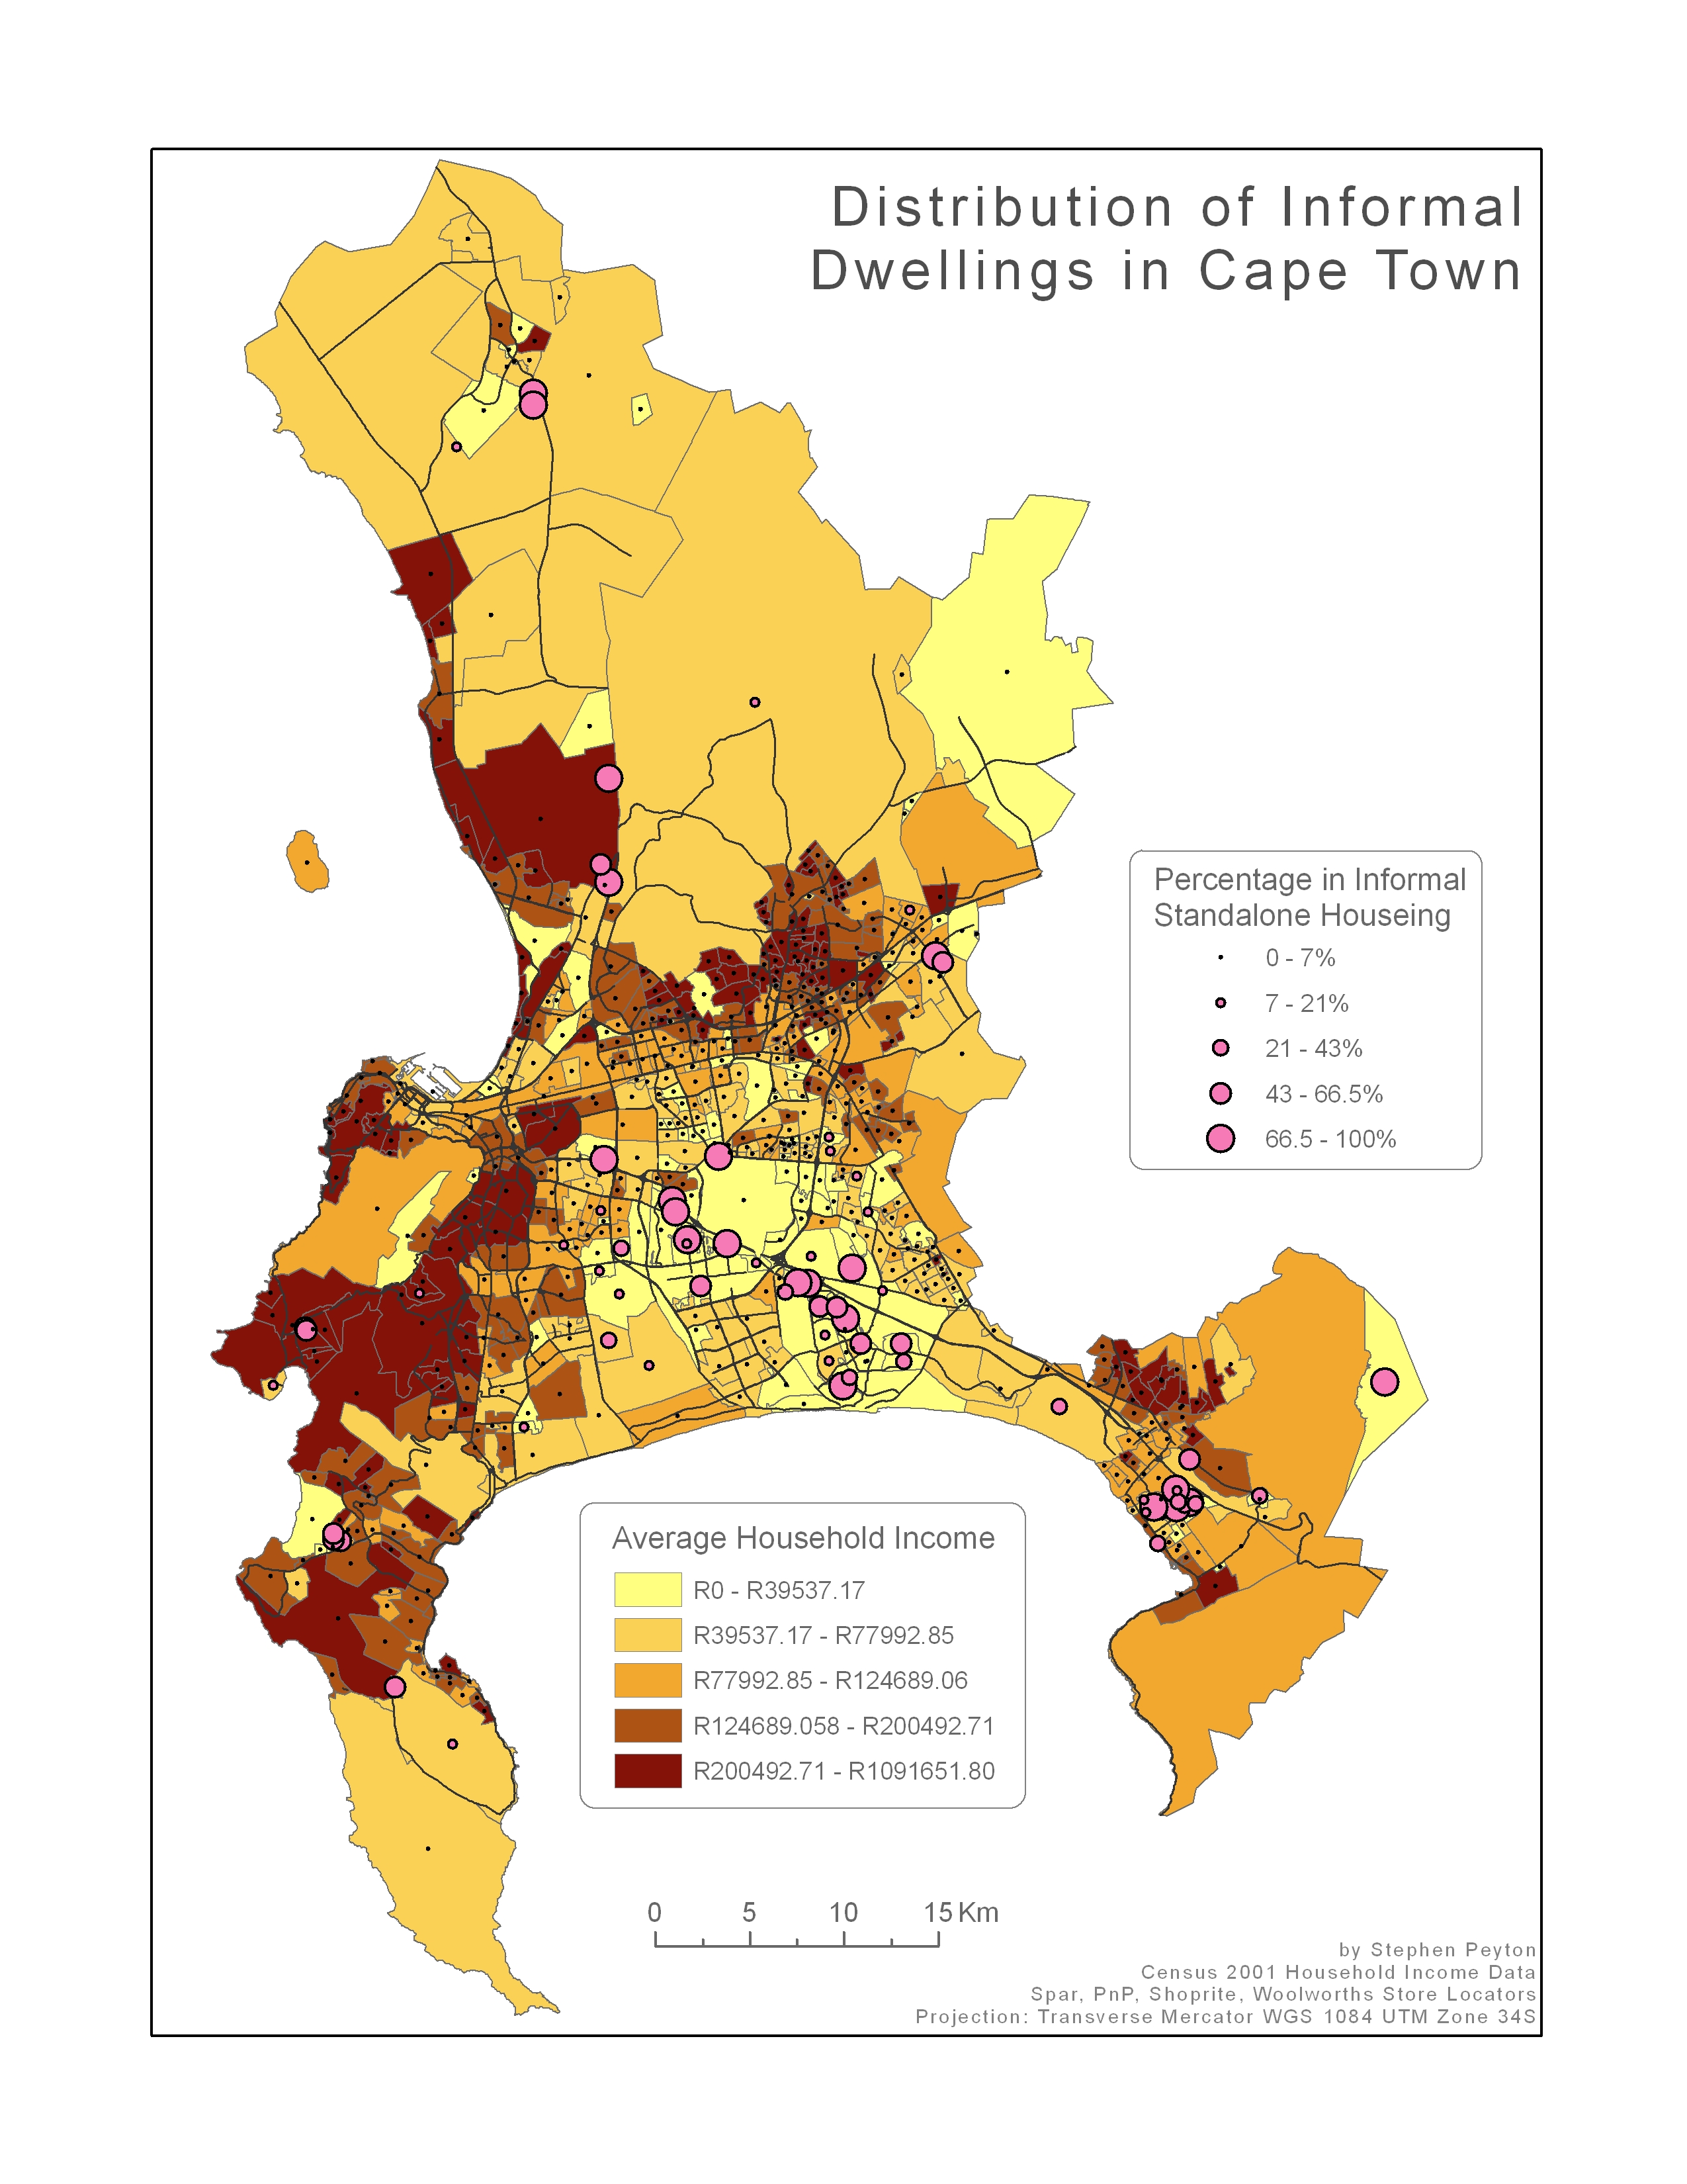
Population: 1996 – 2.5m, 2001, 2.9m, 2011 – 3.7m
Employment 2011: 49,7%, unemployed 15.6%, Discouraged work seeker – 3.1%, other non-economically active – 31.6%
Income: 47% of households monthly income less that R3200p.m.

Slide 3
Levels of food insecurity: AFSUN 2008
All Cape Town sites

Slide 4
AFSUN 2013 data

Slide 6
% of households consuming home grown food.

Slide 7
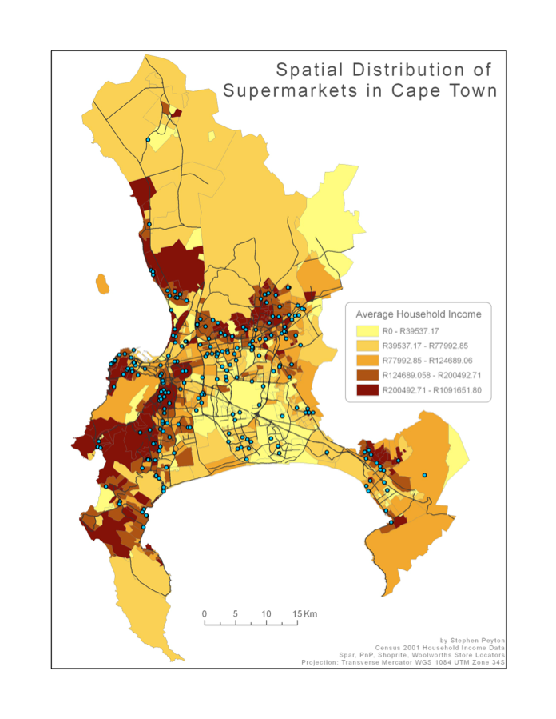
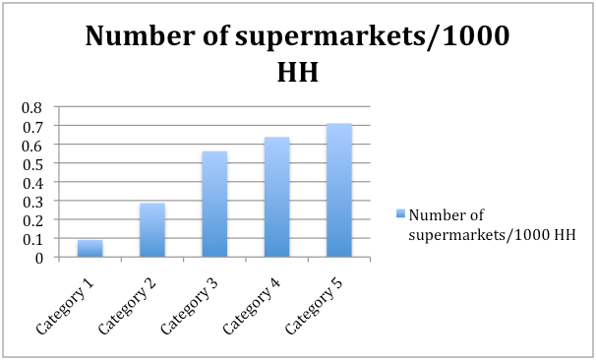

Slide 8
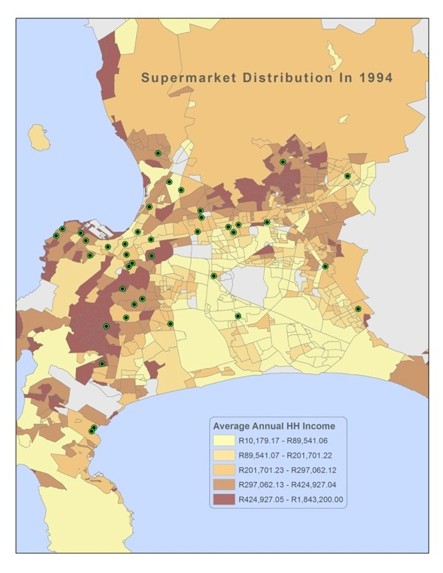
Notes:
Rapid, but previously unmapped and untracked expansion of supermarkets in Cape Town. Assumptions of a “food security win”, but questions arise.

Slide 9
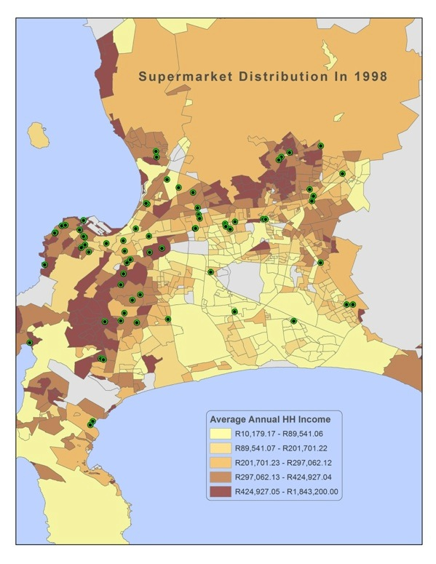

Slide 13
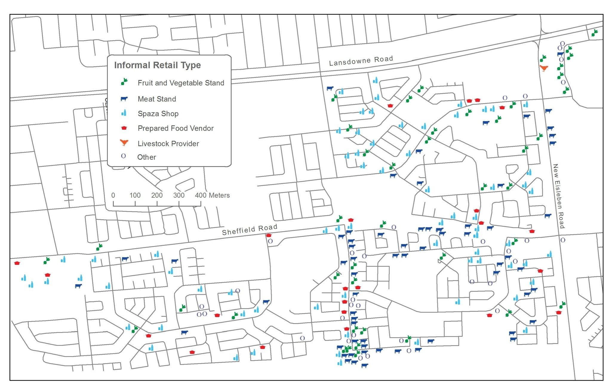
Notes:
Mapping informal food retail and understanding the lived geographies of food and the interplay between the formal and informal food economy.

Slide 14
Traders’ food sourcing

Slide 15
Where does Cape Town’s food come from?

